Slide 1
Graphs
Saba Saeed

Slide 2
Contents
Basics
Representation of of Graph ADT
Search Algorithms

Slide 3
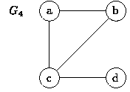
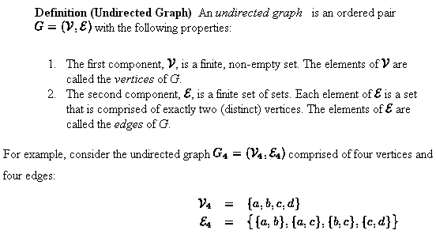
Basics

Slide 4
Basics:
Definition (Directed Graph) A directed graph , or digraph , is an ordered pair G=(V,E) with the following properties:
The first component, V , is a finite, non-empty set. The elements of are called the vertices of G.
The second component, E, is a finite set of ordered pairs of vertices. That is, . . The elements of E are called the edges of G.
For example, consider the directed graph comprised of four vertices and six edges:

Slide 5
Basics
Undirected edge between u and v is denoted by {u,v}
directed edge between u and v is denoted by (u,v)
Shorthand for {u,v} or (u,v) is uv
For undirected graph uv and vu both are the same.
Graphs that have both directed and undirected edges are called mixed graphs

Slide 6
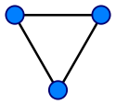
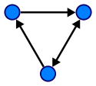
Basics
Directed graph G
Underlying undirected graph of G

Slide 7
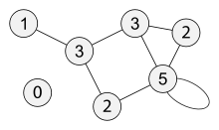
Degree of a graph
For undirected graphs:
The degree of a graph vertex of a graph is the number of graph edges which touch v
Graph with vertices labeled by its degree

Slide 8
Degree of a graph
For directed graphs:
Indegree : The number of inward directed graph edges from a given graph vertex in a directed graph.
Out Degree : The number of outward directed graph edges from a given graph vertex in a directed graph.

Slide 9
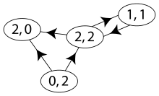
Example
Graph with vertices labeled as (indegree, outdegree)

Slide 10
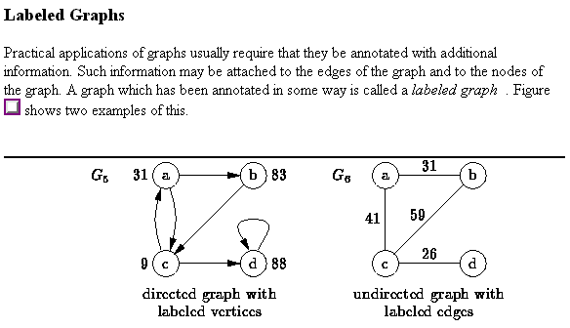
Basics

Slide 11
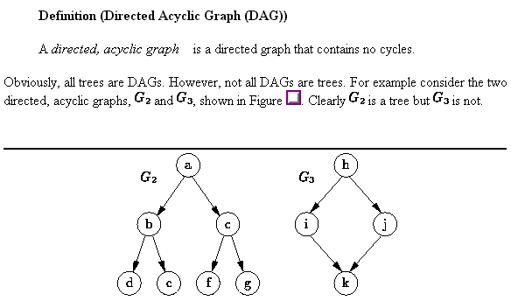
Basics

Slide 12
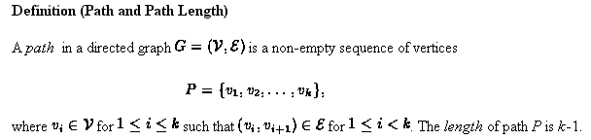
Basics

Slide 13
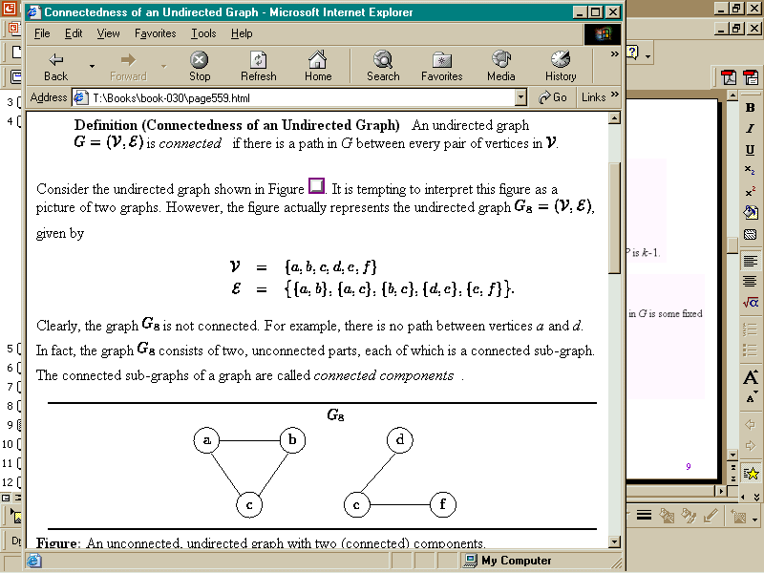
Basics

Slide 14
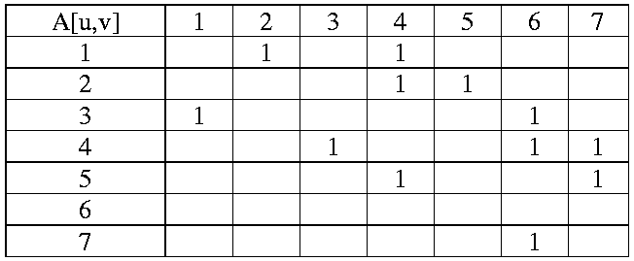
Representation: Adjacency Matrix
1
2
3
4
5
6
7

Slide 15
it takes Θ(V), even if the graph is sparse: relatively few edges. In other words, for a sparse graph, the adjacency matrix is mostly 0s, and we use lots of space to represent only a few edges.

Slide 16
Edge List
One simple way to represent a graph is just a list, or array, of |E|, which we call an edge list. To represent an edge, we just have an array of two vertex numbers, or an array of objects containing the vertex numbers of the vertices that the edges are incident on. If edges have weights, add either a third element to the array or more information to the object, giving the edge's weight. Since each edge contains just two or three numbers, the total space for an edge list is Θ(E).

Slide 17
Edge list
[ [0,1], [0,6], [0,8], [1,4], [1,6], [1,9], [2,4], [2,6], [3,4], [3,5],
[3,8], [4,5], [4,9], [7,8], [7,9] ]

Slide 18
Representation: Adjacency List
1
2
3
4
5
6
7
1
2
3
4
5
6
7
2
4
3
4
5
6
6
7
3
4
7
6

Slide 19
We can get to each vertex's adjacency list in constant time, because we just have to index into an array. To find out whether an edge (i,j) is present in the graph, we go to i's adjacency list in constant time and then look for j in i's adjacency list. How long does that take in the worst case? The answer is Θ(d) where d is the degree of vertex i, because that's how long i's adjacency list is. The degree of vertex i could be as high as |V|-1 (if i is adjacent to all the other |V|-1) or as low as 0.

Slide 20
Trees and Forests
A (free) tree is an undirected graph T such that
T is connected
T has no cycles
A forest is an undirected graph without cycles
The connected components of a forest are trees

Slide 21
Graph Traversal
Problem: Search for a certain node or traverse all nodes in the graph
Depth First Search
Once a possible path is found, continue the search until the end of the path
Breadth First Search
Start several paths at a time, and advance in each one step at a time

Slide 22
Breath first search
The order of search is across levels.
The root is examined first; then both children of the root; then the children of those nodes, etc.
Sometimes we can stop the algorithm if we are looking for a particular element, but the general BFS algorithm runs through every node.

Slide 23
For example
Pick a source vertex S to start.
Find (or discover) the vertices that are adjacent to S.
Pick each child of S in turn and discover their vertices adjacent to that child.
Done when all children have been discovered and examined.
This results in a tree that is rooted at the source vertex S.
The idea is to find the distance from some Source vertex by expanding the “frontier” of what we have visited.

Slide 24
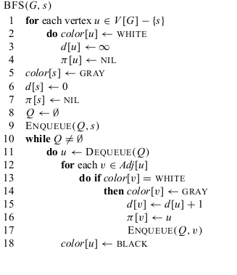
BFS Algorithm
The breadth-first-search procedure BFS below assumes that the input graph G = ( V , E ) is represented using adjacency lists. It maintains several additional data structures with each vertex in the graph.
The color of each vertex u ∈ V is stored in the variable color[u ],
The predecessor of u is stored in the variable π [u ].
If u has no predecessor (for example, if u = s or u has not been discovered), then π [u ] = NIL
. The distance from the source s to vertex u computed by the algorithm is stored in d [u ].
The algorithm also uses a fi rst-in, first-out queue Q

Slide 25
Breadth-First Search - Example
a
s
b
c
d
e
f
g

Slide 26
Breadth-First Search - Example
a
s
b
c
∞
0
∞
∞
∞
∞
∞
∞
d
e
f
g
Q
s

Slide 27
Breadth-First Search - Example
a
s
b
c
1
0
∞
∞
∞
1
∞
∞
d
e
f
g
Q
e | a

Slide 28
Breadth-First Search - Example
a
s
b
c
1
0
2
∞
∞
1
2
∞
d
e
f
g
Q
a | b | f

Slide 29
Breadth-First Search - Example
a
s
b
c
1
0
2
∞
2
1
2
∞
d
e
f
g
Q
b | f | d

Slide 30
Breadth-First Search - Example
a
s
b
c
1
0
2
3
2
1
2
∞
d
e
f
g
Q
f | d | c

Slide 31
Breadth-First Search - Example
a
s
b
c
1
0
2
3
2
1
2
3
d
e
f
g
Q
d | c | g

Slide 32
Breadth-First Search - Example
a
s
b
c
1
0
2
3
2
1
2
3
d
e
f
g
Q
c | g

Slide 33
Breadth-First Search - Example
a
s
b
c
1
0
2
3
2
1
2
3
d
e
f
g
Q
g

Slide 34
Breadth-First Search - Example
a
s
b
c
1
0
2
3
2
1
2
3
d
e
f
g
Q = ∅

Slide 35
Analysis
Each vertex is enqueued at most once, and hence dequeued at most once.
The operations of enqueuing and dequeuing take O ( 1) time, so the total time devoted to queue operations is O ( V ) .
Because the adjacency list of each vertex is scanned only when the vertex is de-queued, each adjacency list is scanned at most once.

Slide 36
Since the sum of the lengths of all the adjacency lists is O(E ) , the total time spent in scanning adjacency lists is O ( E )
Thus the total running time of BFS is O ( V + E ).

Slide 37
Depth First search
The strategy followed by depth-first search is, as its name implies, to search “deeper ” in the graph whenever possible.
In depth- first search, edges are explored
out of the most recently discovered vertex v that still has unexplored edges leaving it.
When all of v ’s edges have been explored, the search “backtracks” to explore edges leaving the vertex from which v was discovered.

Slide 38
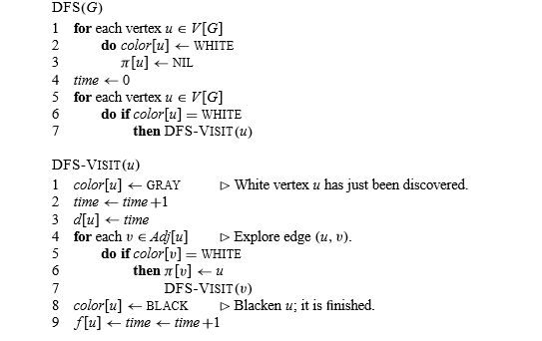
Depth First search

Slide 39
